Slide 1
Summary 31/07 Filip Krasniqi, Jocelyne Elias and Jérémie Leguay
July 31, 2019

Slide 2
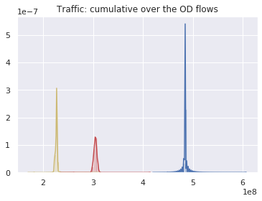
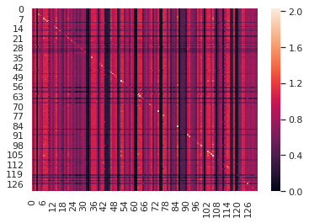
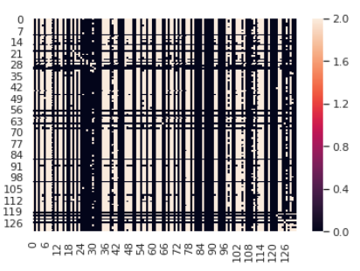
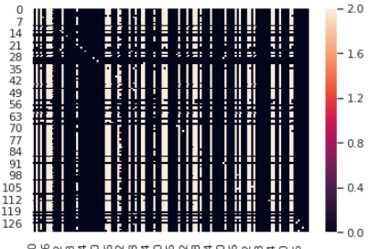
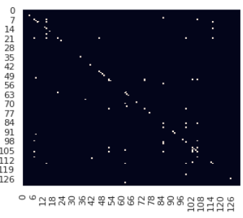
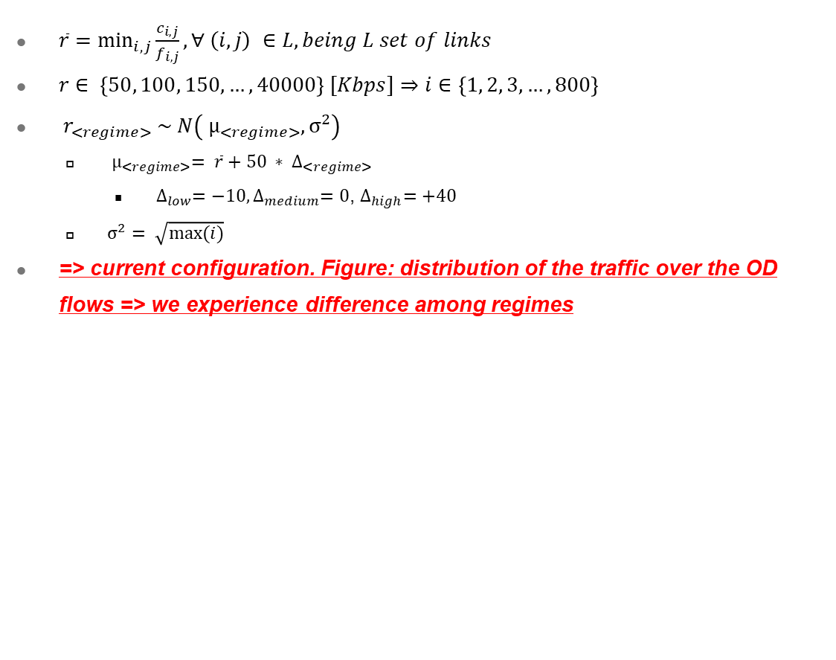
Final configuration of regimes
$\overline{r}=$ $\min_{i,j}{\frac{c_{i,j}}{f_{i,j}}}, ∀ \left(i,j\right) ∈L, being L set of links$
$r∈ \left\{50, 100, 150, …, 40000\right\} [Kbps]⇒i∈$ $\left\{1, 2, 3, …, 800\right\}$
${ r}_{<regime>} \sim N\left({ µ}_{<regime>},{\text{σ}}^{2}\right)$
${ µ}_{<regime>}= \overline{r}+50 ∗ ∆_{<regime>}$
$∆_{low}=−10,∆_{medium}=0$, $∆_{high}=+40$
${\text{σ}}^{2}= \sqrt{max⁡(i)}$
=> current configuration. Figure: distribution of the traffic over the OD flows => we experience difference among regimes
Mutual info m_i between traffic matrix and delay
Applying threshold T = 0.8.
White = higher than T
T = 1.2
T = 1.4

Slide 3
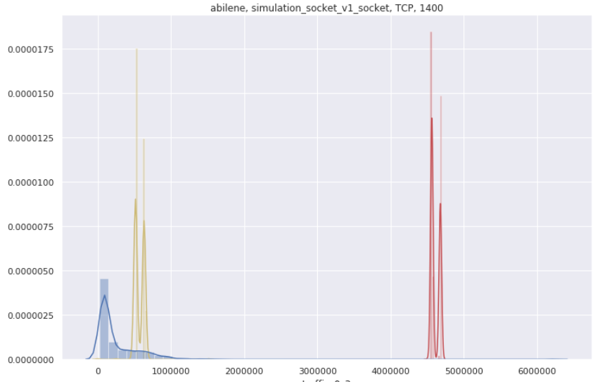
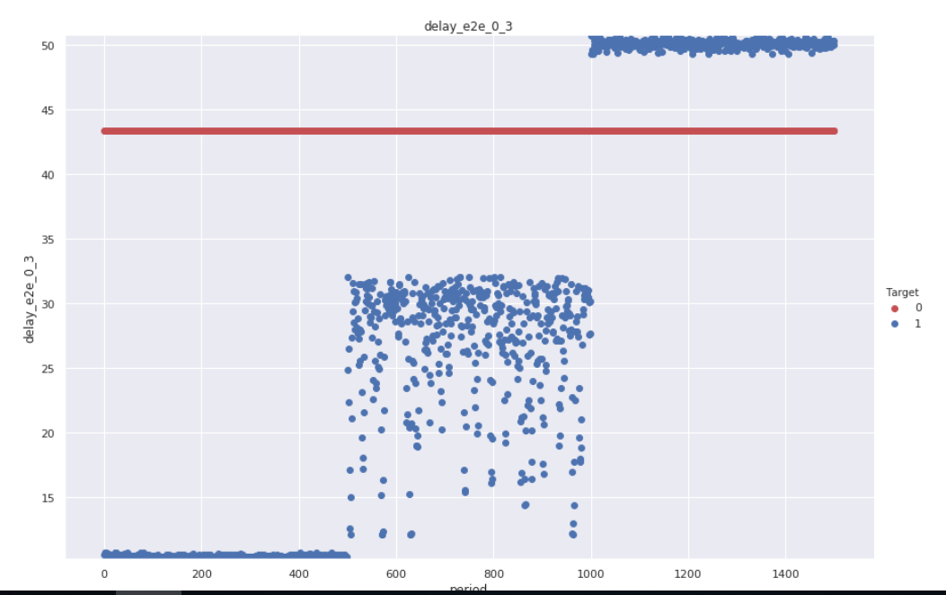
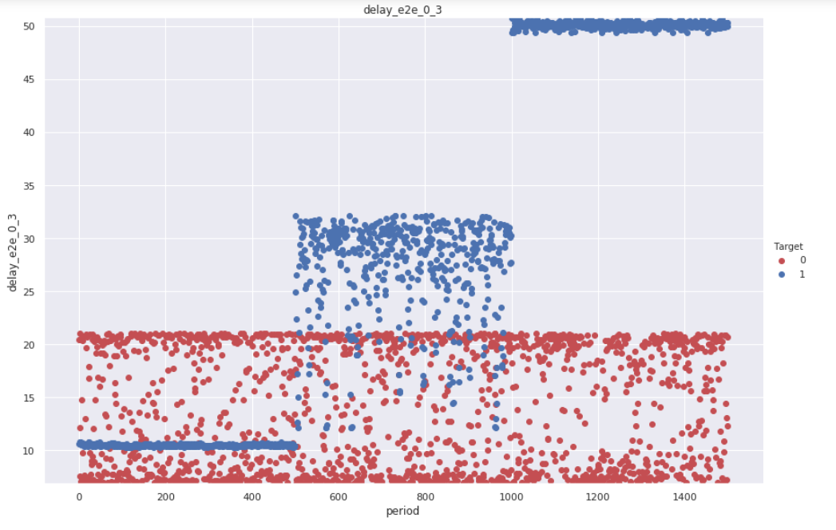
Example: distribution for OD flow O = 0, D = 3
Low, medium, high
Abilene, TCP socket
Figure 1: Traffic distribution is reasonable (TCP)
Predicted, target
Example of delay with high difference between low, medium and high
Missing values are handled
Figure 2: learning D = F(T) with a complex NN that learns prudently
Low learning rate, high regularization. Result: no variance captured
Figure 3: learning D = F(T) with a simpler NN that learns less prudently
Higher learning rate, lower regularization. Result: higher variance, still no capability of distinguishing regime
Goal: add features in input and data with higher granularity of intensity to capture regime differences
Figure 1: traffic distribution
Figure 2
Figure 3

Slide 4
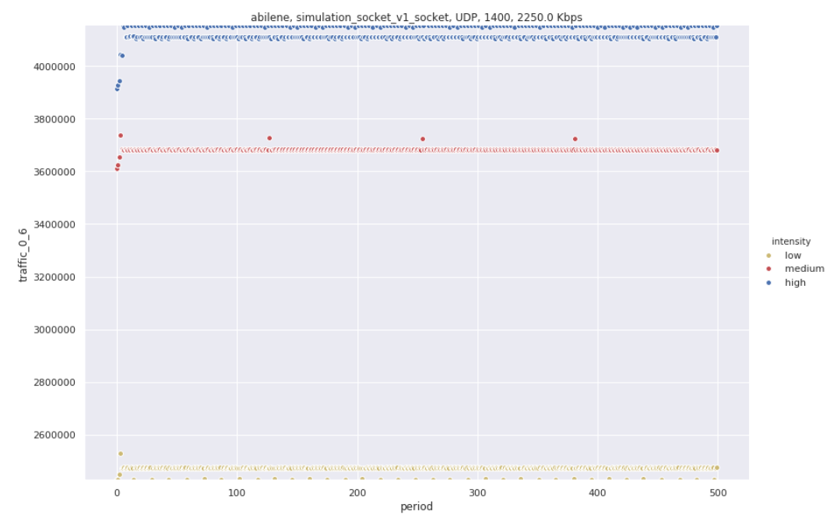
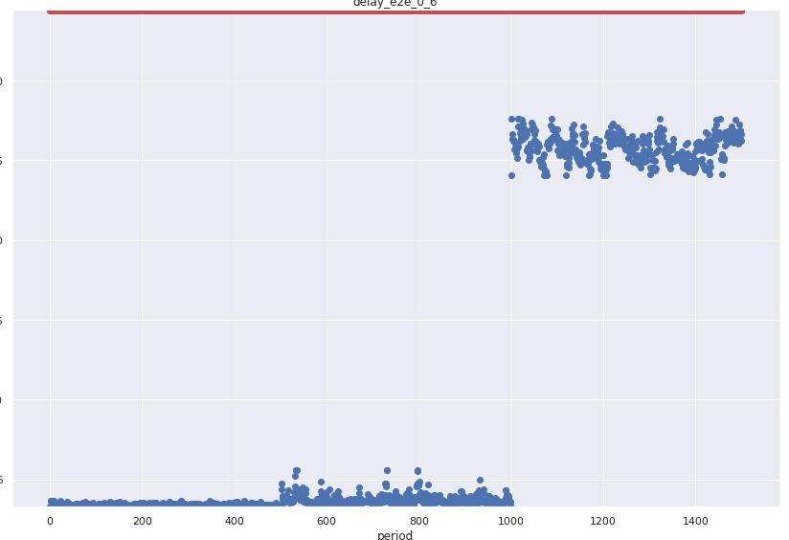
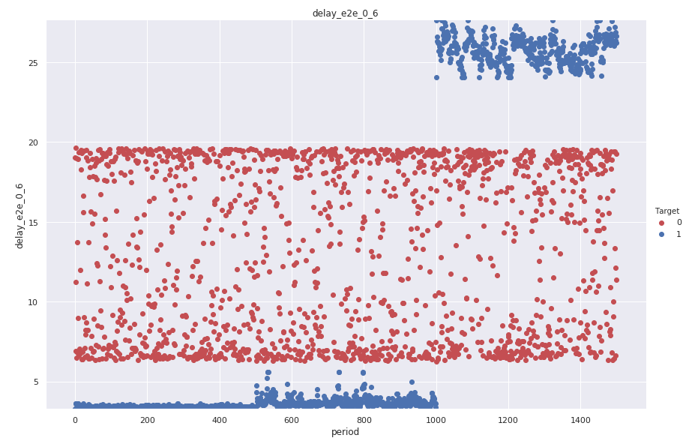
Example: distribution for OD flow O = 0, D = 6
Low, medium, high
Abilene, UDP CBR
Figure 1: Traffic plot (x = epoch) is reasonable
Predicted, target
Example of delay with high difference between low, medium and high
Missing values are handled
Figure 2: learning D = F(T) with a complex NN that learns prudently
Low learning rate, high regularization. Result: no variance captured
Figure 3: learning D = F(T) with a simpler NN that learns less prudently
Higher learning rate, lower regularization. Result: higher variance, still no capability of distinguishing regime
Goal: add features in input and data with higher granularity of intensity to capture regime differences
Figure 2
Figure 3

